Slide 1

W. Demesh Fernando
Index No. 22863

Slide 2
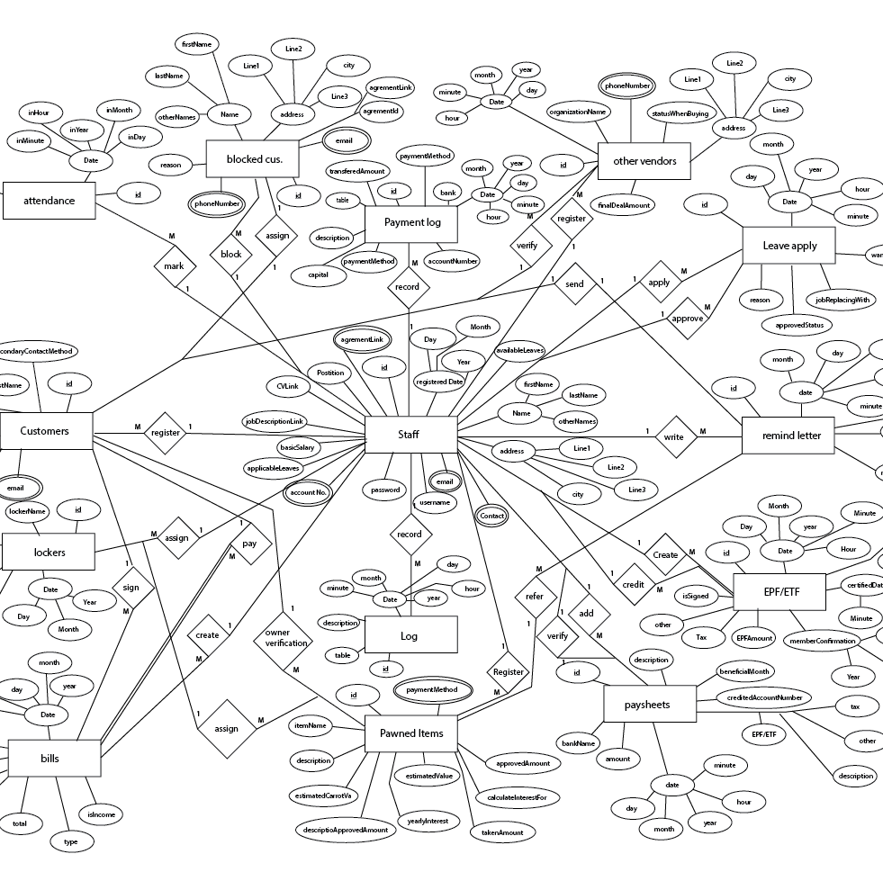
ER Diagram of developed DK Pawning center software.

Slide 3
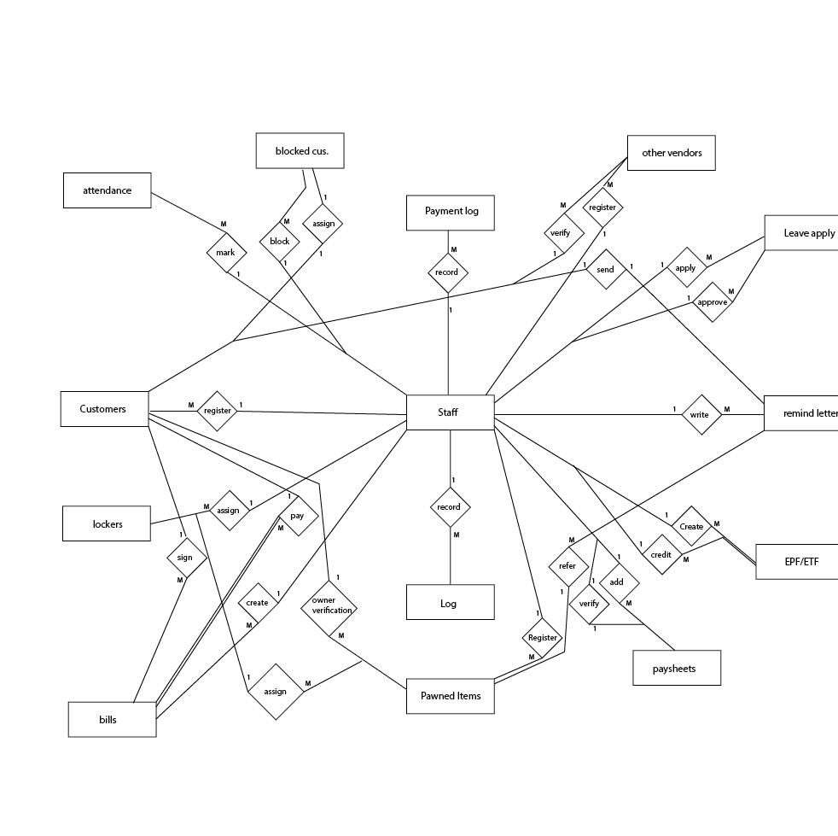
Tables and connection of the ER Diagram without attributes and other aspects.
There are many tables that need to be discussed in this ER.
Customers
Staff
Lockers
Bills
Pawned Items
Paysheets
EPF/ETF
Remind letter
Leave application
Other vendors
Blocked Customers
Attendance
General log
Payment log

Slide 4
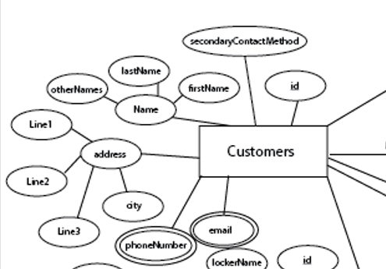
Customers table
This is where all customer details will be stored.
We use this table to store,
Id
Name of the customer
Address of the customer
Phone numbers
Email addresses of the customer
A secondary contact method of the customer

Slide 5
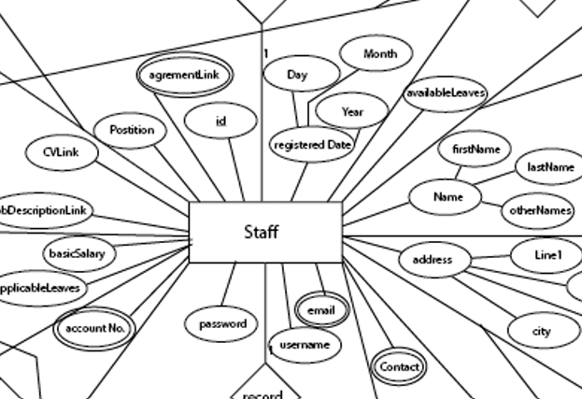
Staff table
This table is used to store all the staff member details in the company.
We use this table to store employees,
Id
Agreement details
Position id
Offer letter
Salary details
Leave applications
Account no.
Username and password
Email and contact numbers
Address
Registered date

Slide 6
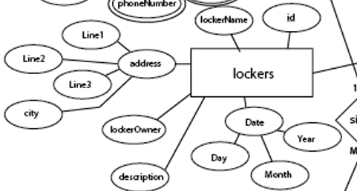
Locker table
This table will store all the details of the lockers available in the company.
In this table we use to store,
Locker id
Locker name
Address of the locker
Locker owner
Description about the locker
Locker registered date

Slide 7
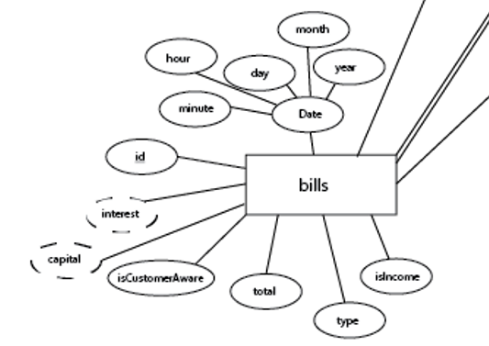
Bills table
This table is used to store all the bill items that are printed in the company.
This table is used to store,
Id
Interest rate
Capital amount
Printed date
Customer awareness
Total paid amount
Type of the bill
Whether it is an income or not

Slide 8
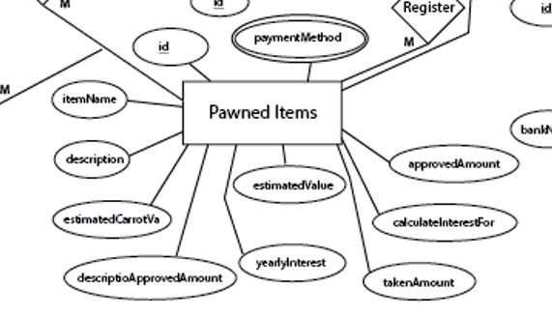
Pawned items
This table is used to store all the mortgage details that are stored in the locker.
This table can be used to identify what are the assets the company is consisted with
Id
Payment method
Item name
Description
Estimated carrot value of the jewellery
Approved amount
Interest rate
Etc.

Slide 9
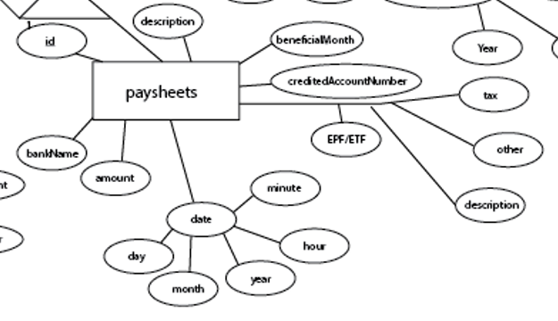
Paysheets table
This table is used to store all the paid paysheets to the employees in the company.
This keep track of
Id
Bank name where the money was sent
Amount
Sent date
Beneficial month
Description
Account number
Cut offs from the salary

Slide 10
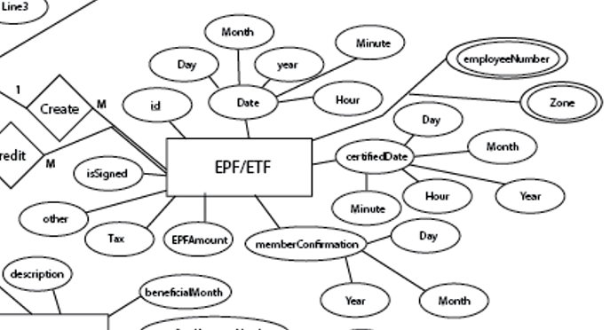
EPF or ETF table
This table is used to store all the details regarding employees EPF or ETF accounts
This table has,
Id
Date of registration happened
Employee number and zone
Certified date
Member confirmation
EPF amount
Paid tax
Employee awareness.

Slide 11
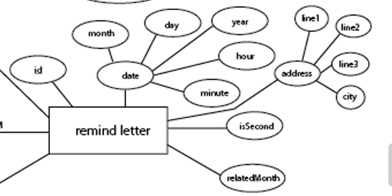
Remind letters table
This table is used to keep track of all the sent remind letters to the customers in the company
These letters are sent when the customer delay the payments
This table has,
Id
Date of registration
Address of sent
Related month of this letter

Slide 12
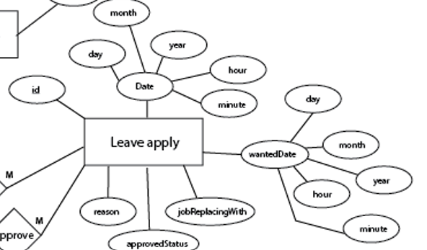
Leave application table
This table is used to keep track of the employees who requested the leaves and when they are getting the leaves and for what reason.
This table has,
Id
Date of the application sending
Leave wanted date
Who will look after the role
Status of approval
Reason of the application

Slide 13
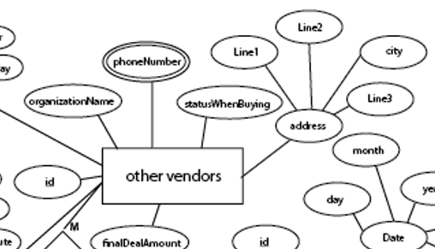
Other vendors table
This table is used to store vendor list where when there is a recovery of a loosing gold item for the customer.
This table has,
Id
Final deal amount
Address of the vendor
Status of the gold
Phone number
Name of the organization

Slide 14
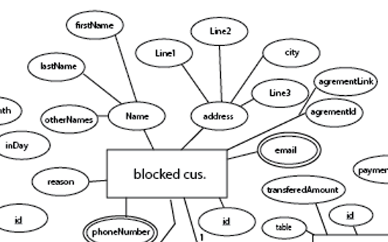
Blocked customer table
This table is used to store when there are customers who has the record of not paying the payment on the time.
This table has,
Id
Email
Address
Name
Reason of the blocking

Slide 15
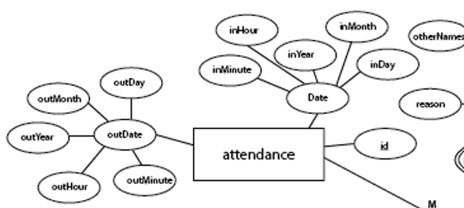
Attendance registry table
This table is used to keep track of the attendance of the employees in the company.
This table has,
Id
Started date of the work
End dates of the work.

Slide 16
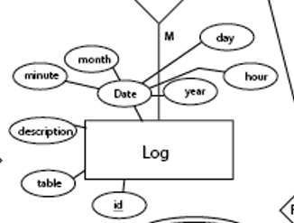
General log table
This table is used to keep logs and maintain them. This will prevent nonrepudiation and will help in forensics.
This table has,
Id
Referring table
Date of the activity

Slide 17
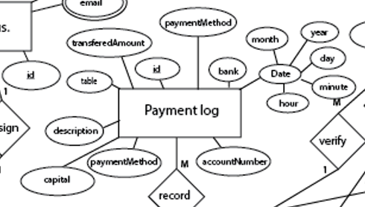
Payment log table
This table will keep track of all the payment that are happening inside the organization.
This has,
Id
Transferred amount
Date of the transaction
Bank transferred to
Payment method
Description
Capital and interest rate

Slide 18
